Slide 1
₹
FinAI
An AI-Driven Personal Finance, Investment Analytics and
Financial Intelligence Platform
M.TECH D I S S E R T A T I O N · INTERNAL REVIEW 1
Phase 1 - Foundation & Core Financial Management
September 2026
Notes:
Introduce the project in one line: a single platform where daily expenses, budgets and AI-generated, evidence-backed insight live together. Phase 1 is complete and demoable end to end.

Slide 2
₹
REVIEW 1
Agenda
01
Problem statement & existing system limitations
02
Research gap and proposed system objectives
03
System architecture & technology stack
04
Database, API and security design
05
Phase 1 AI module: anomalies, insights, health score
06
UI prototype, implementation status & test results
07
Limitations and the Phase 2 roadmap
FinAI · M.Tech Review 1 · Phase 1
2

Slide 3
₹
WHY THIS PROJECT
Problem Statement
Existing tools record financial life but never explain it. Scores are black boxes, investment analysis is divorced from daily behaviour, and AI output - where it exists - is unsupported by the user's actual data.
■
■
■
Passive tracking
Black-box scores
Ungrounded AI
Apps display spending but never interpret change, cause or action.
A number appears with no factors, weights or arithmetic to verify.
Generic tips that no dataset supports - hallucination, not analysis.
Target: an integrated, explainable, data-grounded financial intelligence platform.
FinAI · M.Tech Review 1 · Phase 1
3

Slide 4
₹
LITERATURE SURVEY
Existing System Limitations
Spreadsheet budgets
Manual, error-prone, zero automation or anomaly detection
Bank / UPI apps
Capture transactions but only record - no interpretation
Expense trackers
Charts without meaning: no guards, no evidence, no scoring
Investment trackers
Detached from daily spending; opaque return metrics
Robo-advisory tools
Black-box recommendations; advice, not education
FinAI · M.Tech Review 1 · Phase 1
4
Notes:
Five tool families surveyed. The pattern: recording is solved, explanation is not.

Slide 5
₹
FROM SURVEY TO PROPOSAL
Research Gap → FinAI Answer
1
Tracking without explanation
→
Guarded insight engine: every insight cites its evidence
2
Black-box scores
→
Weighted health score with visible per-factor contributions
3
No integrated research
→
Stock analyzer + valuation + sentiment (Phase 2, provider-abstracted)
4
AI without grounding
→
RAG assistant with mandatory citations; refuses on empty retrieval (P4)
5
Planning divorced from behaviour
→
Goals & calculators consume the user's real expense history (P3)
FinAI · M.Tech Review 1 · Phase 1
5

Slide 6
₹
WHAT PHASE 1 DELIVERS
Proposed System & Objectives
Objectives
Explicitly out of scope
Secure layered architecture with RBAC and versioned disclaimer governance
No F&O recommendations
Derivatives trading is outside platform scope - higher complexity and risk. Stated in the product itself.
Not investment advice
Analytical and educational only. A versioned risk disclaimer must be accepted before use; acceptance (version, IP, time) is stored.
Expense, income and budget management with threshold alerts
Statistically grounded AI: anomaly detection, guarded insights, transparent scoring
Measurable evaluation for every model (precision / recall / F1 / MAPE)
47
tests passing
35
REST endpoints
Phase 2-4: investment analytics → portfolio intelligence → RAG assistant
8
DB entities
4
dev phases
FinAI · M.Tech Review 1 · Phase 1
6

Slide 7
₹
LAYERED DISCIPLINE
System Architecture
Browser SPA
React 18 + TypeScript + Tailwind - glassmorphism dashboard
Layer rules
Routes never contain business logic
API routes
FastAPI · validation · JWT auth · RBAC · rate limiting
Services never touch HTTP constructs
Services
Business rules: auth, expenses, budgets, analytics, admin, audit
Engine pure computation - unit-testable without I/O
Analysis engine
Pure functions - aggregation · anomaly · insights · scoring (no I/O)
Data no business rules
Data access
SQLAlchemy 2.0 models + session scoping
Startup waits for database readiness; /healthz reports app + DB status.
PostgreSQL (prod) / SQLite (dev) · Redis + external providers reserved for Phase 2+
FinAI · M.Tech Review 1 · Phase 1
7

Slide 8
₹
CHOICES WITH REASONS
Technology Stack & Justification
Backend
FastAPI + Pydantic v2
Async, typed contracts, auto-OpenAPI; fits Python ML ecosystem
Database
PostgreSQL 16 / SQLite dev
One SQLAlchemy schema - zero-setup laptop demo, production-grade deploy
Auth
JWT 30 min + rotating refresh, bcrypt
Revocable hashed sessions; no plaintext credentials
Frontend
React 18 + TypeScript + Vite
Private dashboard: no SSR benefit; fast builds, strict types
UI / charts
Tailwind 3 + Recharts
Consistent glass design system; light chart composition
Testing
pytest + TestClient
Isolated DB per test; public-API-driven integration
Deploy
Docker Compose
postgres + redis + api + nginx web - production-shaped
FinAI · M.Tech Review 1 · Phase 1
8

Slide 9
₹
PHASE 1 ENTITIES
Database Design
users
session_tokens
disclaimer_acceptances
password_reset_tokens
expense_categories
expenses
incomes
budgets
audit_logs
Design decisions
Money = Numeric(14,2) - floating point never touches currency
Soft deletion - analytics history survives corrections
Token digests only - HMAC-SHA256 of refresh tokens; a DB leak yields nothing usable
Composite indexes - (user_id, expense_date) · (user_id, category_id) · token_hash unique
System vs custom categories - system rows shared, deletion-guarded at service layer
FinAI · M.Tech Review 1 · Phase 1
9

Slide 10
₹
JWT + ROTATING REFRESH
Authentication Architecture
1
2
3
4
Login
Token pair
Refresh rotates
Sessions
bcrypt verify; 5 failures → 15 min lock; audit-logged
access JWT 30 min (jti) + refresh 14 days stored as HMAC digest
used token revoked & replaced - replay fails fast
list devices, revoke any; logout revokes server-side
Disclaimer governance & hardening
Versioned disclaimer acceptance (version, IP, timestamp) persisted; login blocked until current version accepted
Brute force per-IP rate limit 10/5 min + account lockout + failure audit
Reset flow single-use expiring hashed tokens; dev-only visibility; all sessions revoked on reset
Transport Authorization-header tokens only - no cookie CSRF surface; nosniff, DENY, no-store headers
FinAI · M.Tech Review 1 · Phase 1
10

Slide 11
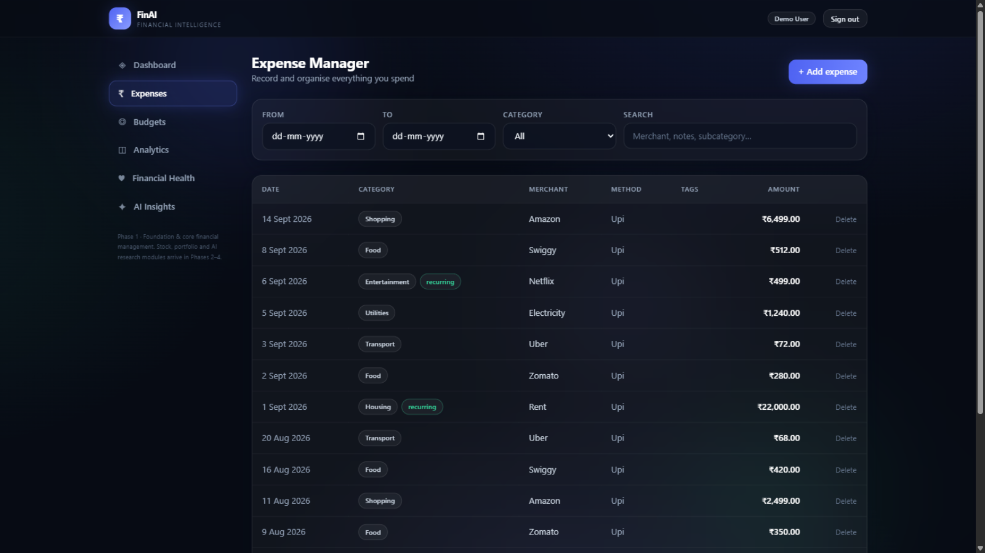
₹
MODULE WALKTHROUGH
Expense & Budget Management
Full metadata date, amount, category/subcategory, payment method, merchant, tags, notes
Recurring flags feed the recurring-load insight and recurring-ratio score
Custom categories 12 system categories shared; user categories deletion-guarded
Budgets monthly/yearly, overall or per category, 50/75/90% alert chain
Soft delete + audit history preserved; every change recoverable
Expense manager - filters, search, pagination, custom categories
Budget screens: live utilisation bars, remaining amounts and triggered alerts.
FinAI · M.Tech Review 1 · Phase 1
11

Slide 12
₹
Z-SCORE WITH GUARDS
AI Module · Anomaly Detection
z = (x − μ) / σ flag when z > 2.5
Two detectors: per-transaction within category · daily totals against user baseline
≥ 8 samples
≥ 14 days
per category before any transaction flag
of history before daily-total detection
μ, σ, z, n reported
Silence over invention
every flag carries its reference statistics and a plain-language explanation
thin data produces zero flags, by design
Every flag: amount · mean · std · z-score · sample size · explanation
FinAI · M.Tech Review 1 · Phase 1
12

Slide 13
₹
SIX RULES, EACH CITING EVIDENCE
AI Module · Guarded Insight Engine
Category spike
Concentration
Recurring load
fires when > 1.2× previous month and +₹500
fires when one category > 35% of spend
fires when ≥ 3 merchants over ≥ 3 months
“Food up 185% - ₹2,198 vs ₹770.”
“Housing is 71% of this period.”
“Netflix + Spotify ≈ ₹798/month.”
Weekend pattern
Savings trend
Budget pressure
fires when weekend avg > 1.3× weekday, ≥ 14 days
fires when rate change > ±5 pp, 2 months
fires when utilisation crosses threshold
“Weekends cost 1.6× weekdays.”
“Savings rate fell 8 points.”
“Food budget exceeded - 146%.”
Guard fails → rule stays silent. Guard passes → insight + evidence object with the exact figures.
FinAI · M.Tech Review 1 · Phase 1
13

Slide 14
₹
TRANSPARENT WEIGHTED MODEL
Explainable Financial Health Score
Score = Σ factorScore × effectiveWeight
Factors without data are marked not_evaluated and their weight is redistributed across evaluated ones - the model never invents inputs. Response exposes every weight, factor score and contribution.
weights
85+
70+
55+
40+
<40
Excellent
Good
Fair
Needs Work
At Risk
Live demo output: score 70 (Good) - savings 100 · expense ratio 100 · budget 0 · recurring 0 · emergency 87 · diversification not evaluated (Phase 3)
FinAI · M.Tech Review 1 · Phase 1
14

Slide 15
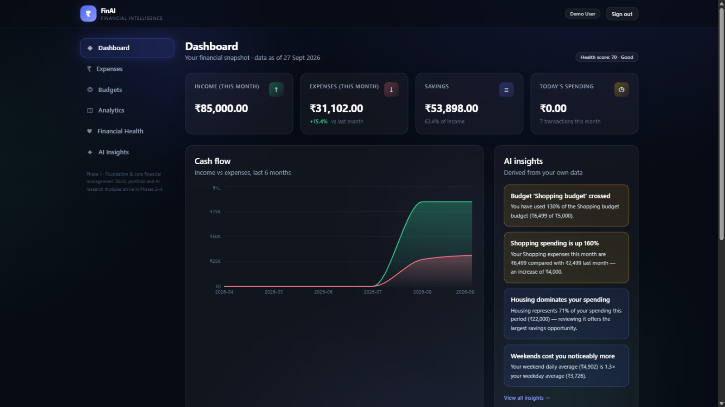
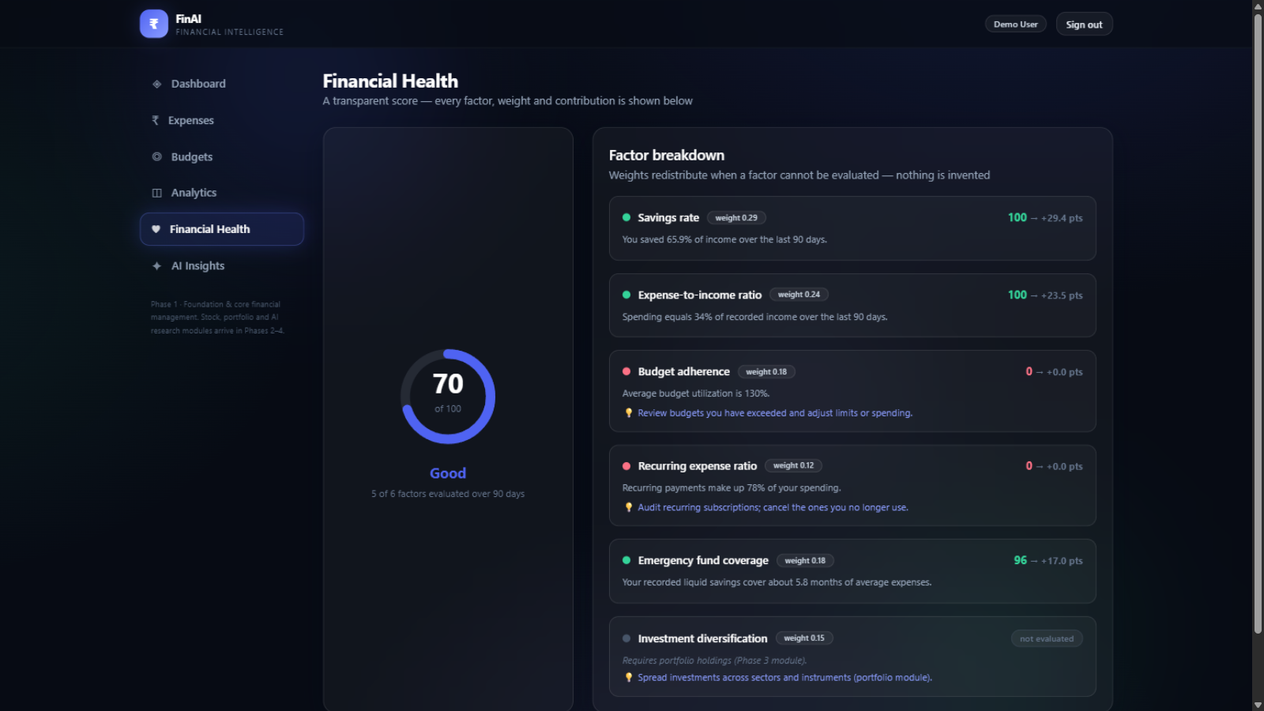
₹
GLASSMORPHISM DESIGN SYSTEM
UI / UX Prototype
Dashboard - snapshot, cash-flow, insights, budgets
Financial health - every factor, weight and contribution
Responsive desktop-first, mobile-ready
Keyboard-accessible forms, ARIA labels
Dark ambient aurora theme, glass cards
Interactive Recharts: donut · bar · line · area
FinAI · M.Tech Review 1 · Phase 1
15

Slide 16
₹
DEFENCE IN DEPTH
Security Design
Authentication
Authorization
bcrypt (cost 12) · JWT +jti · rotating digest-stored refresh · lockout · rate limits 10/5min auth, 120/min mutations
RBAC: users see only their data; admin sees operational counts - never user financial records
Input & injection
Audit & observability
Pydantic schemas on every body · bound-parameter SQL only · React escaping · security headers on all responses
append-only trail: logins, failures, resets, admin actions · suspicious-activity flag on failure bursts
Known Phase 1 limits, tracked openly: dev-only reset tokens · per-process limiter (Redis in P4) · verification stubbed
FinAI · M.Tech Review 1 · Phase 1
16

Slide 17
₹
STATUS
Current Implementation & Testing
47
35
9
13
backend tests, all passing
documented REST endpoints
UI modules delivered
architecture documents
Test strategy
Unit: pure analytics engine, no I/O
Integration: isolated DB per test
Seeding via public API only
pytest.approx for all money math
RBAC + isolation explicitly tested
Test distribution by suite (47 total)
FinAI · M.Tech Review 1 · Phase 1
17

Slide 18
₹
SCRIPTED END-TO-END JOURNEY ON THE DOCKER STACK
Initial Results
Disclaimer
Register
Income
7 expenses
Budget
Dashboard
Insights
Health
RBAC 403
Admin views
ALL CHECKS PASSED - on SQLite (dev) and PostgreSQL (containerised production build)
Insights
2 evidence-backed insights generated: budget pressure + category concentration
Budget alerts
94.1% utilisation triggered the 50 / 75 / 90 alert chain correctly
Health score
95 (Excellent); 5 of 6 factors evaluated - diversification correctly not evaluated
RBAC
user forbidden on admin endpoints (403); admin overview + audit trail verified
FinAI · M.Tech Review 1 · Phase 1
18

Slide 19
₹
HONEST SCOPE
Limitations & Phase 2 Roadmap
Current limitations
Phase 2 - Investment Analytics
Market panels show “Data unavailable” - no fabrication before Phase 2
Provider abstraction FinancialDataProvider interface + cache; no site is load-bearing
Rate limiter per-process; Redis backing arrives in Phase 4
Stock analyzer fundamentals, statements, SMA/EMA · RSI · MACD · Bollinger
Password reset via dev tokens until SMTP is wired
Sentiment (Exp. 2) rules vs TF-IDF+SVM vs transformer - precision / recall / F1
Forecasting waits for sufficient history (guards refuse thin data)
Valuation engine DCF with sensitivity grids · PE · PEG · EV/EBITDA · DDM
Scoring + reports explainable stock score; PDF research reports; Alembic begins
Documented, not hidden - see risk register (14 items).
FinAI · M.Tech Review 1 · Phase 1
19

Slide 20
₹
Phase 1: complete, tested, deployed.
47 passing tests · full end-to-end journey on the containerised stack · every AI output explainable and evidence-backed
Next: Phase 2 - Investment Analytics
Provider abstraction · stock analyzer · valuation · sentiment experiment · PDF reports
Thank you · Questions & demonstration ready
Notes:
Offer the live demonstration: the containerized stack is running locally with a seeded demo account.

